Slide 1
EXPENSE TRACKER
GUIDE: Prof. SHIVANI
TEAM MEMBERS:
MUKUL KUMAR SAHU(3)
NARENDRA KUMAR SINGH(4)
NEHA DINGRA(5)

Slide 2
introduction
In our day to day life we struggle a lot to track our expense. As a youngster we never think about how much we spent and where until we fall short of money. We need some applications that can tract our expenses and Usher us minimize our frivolous expenses and to meet our required demand of money in useful matters.

Slide 3
PROBLEM STATEMENT
“If a person is onto a plan of doing some program/event somewhere. But it seems he is running low on budget. He needs to watch every single little penny he spends during the event. Wouldn’t it be great if someone made him an expense tracking application?” we are making such website which will help us in maintaining our expenses in any kind of event.

Slide 4
continued
Login/Signup
Record daily transactions
Multiple expense categories like food, shopping, gift, etc
Plan budget based on shopping habits
Easy to read and visualize expense reports
Get notified of recurring bills and transactions before the due
Keep track of savings to meet your financial goal.

Slide 5

Speech recognition
It gives ability to program to identify words spoken aloud and convert them into readable text.

Slide 6
RESEARCH OBJECTIVES
We need to manage many things in our daily life that’s why we often forget to manage our money. But prominently we need to see our expenses also so that we never fall short of our money.
We will use full stack and machine learning to make our work more efficient.

Slide 7
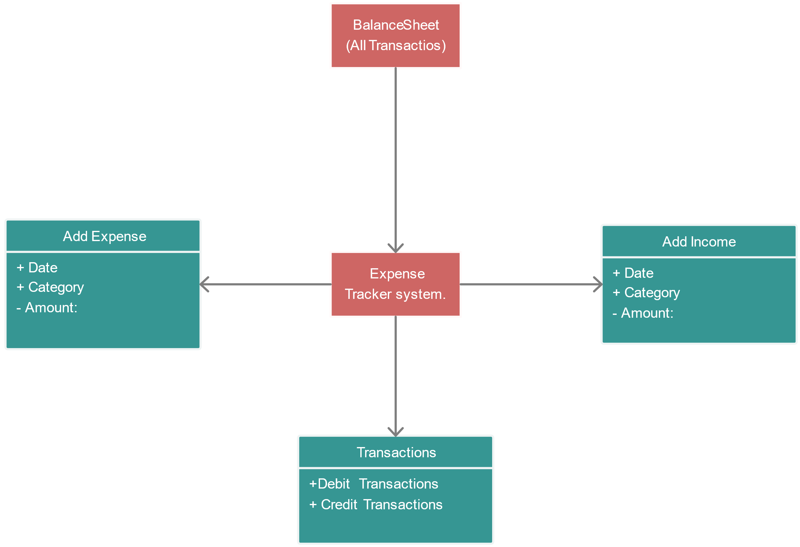
FLOW CHART

Slide 8
Technology to be use
Full Stack
Machine Learning

Slide 9
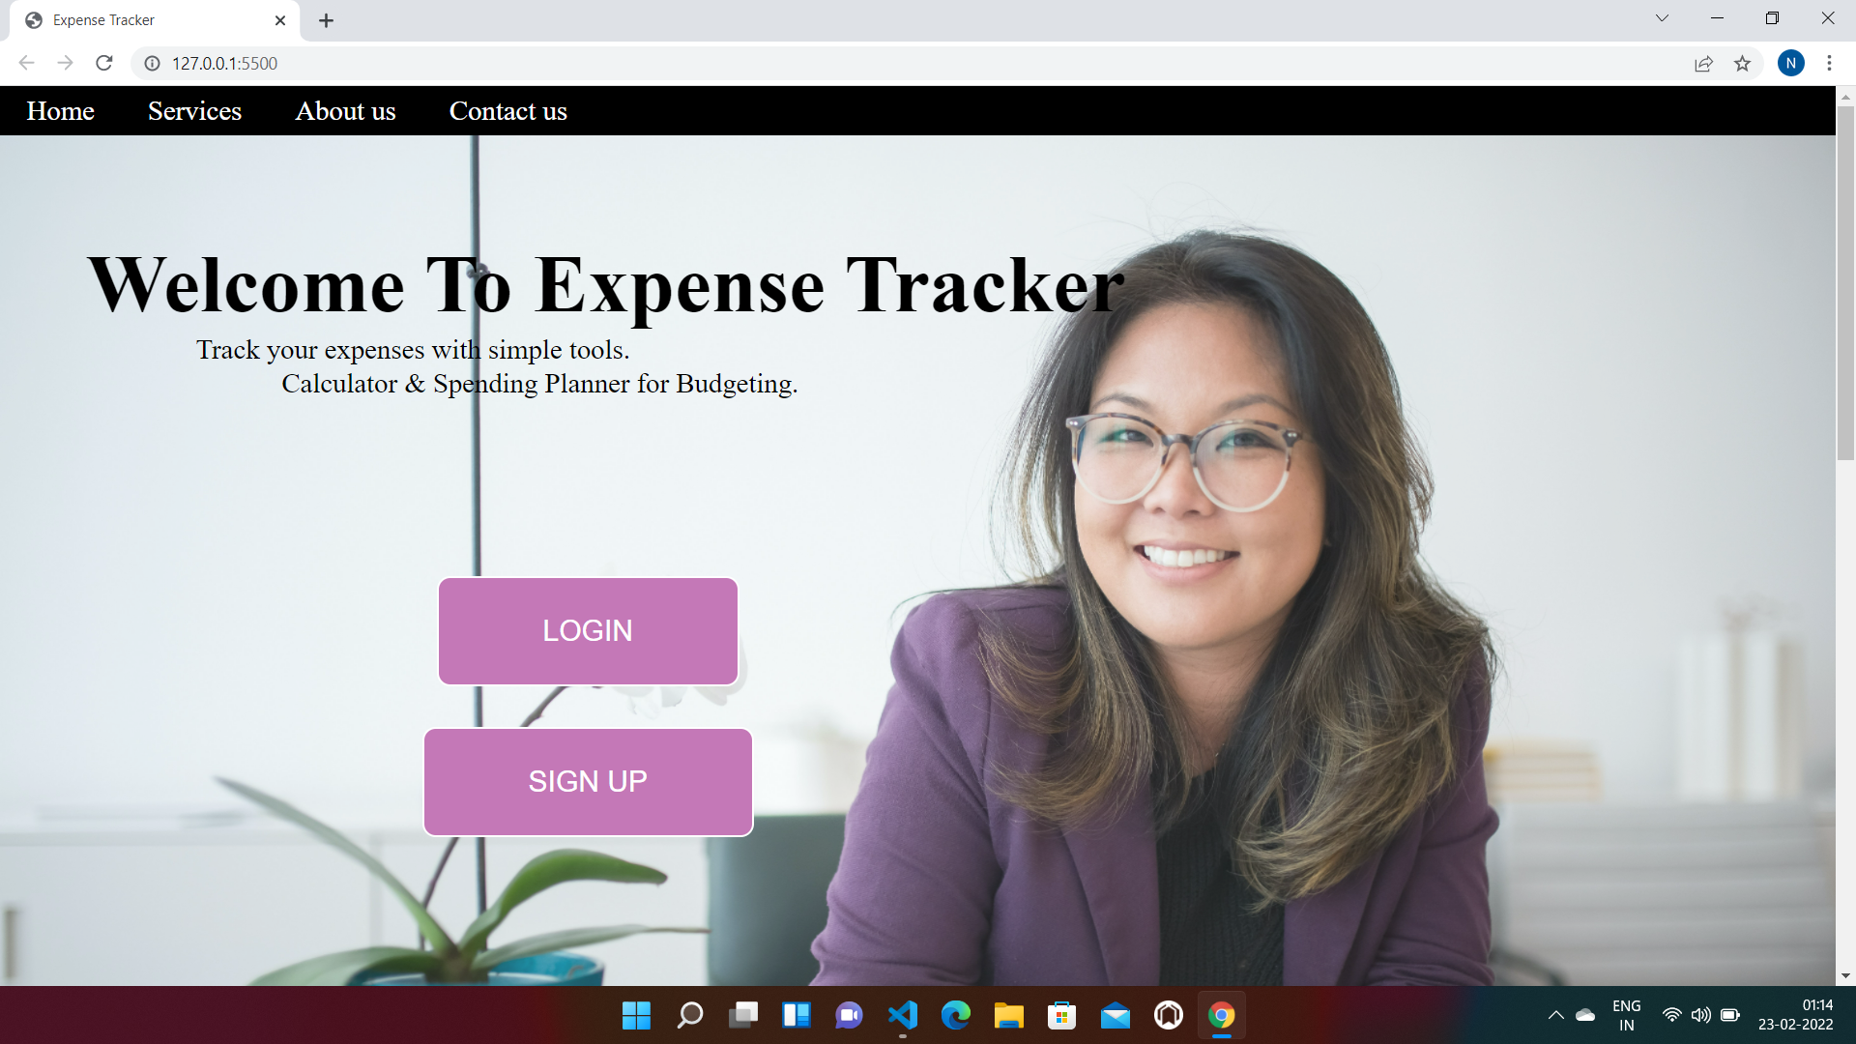
SNAPSHOTS

Slide 10
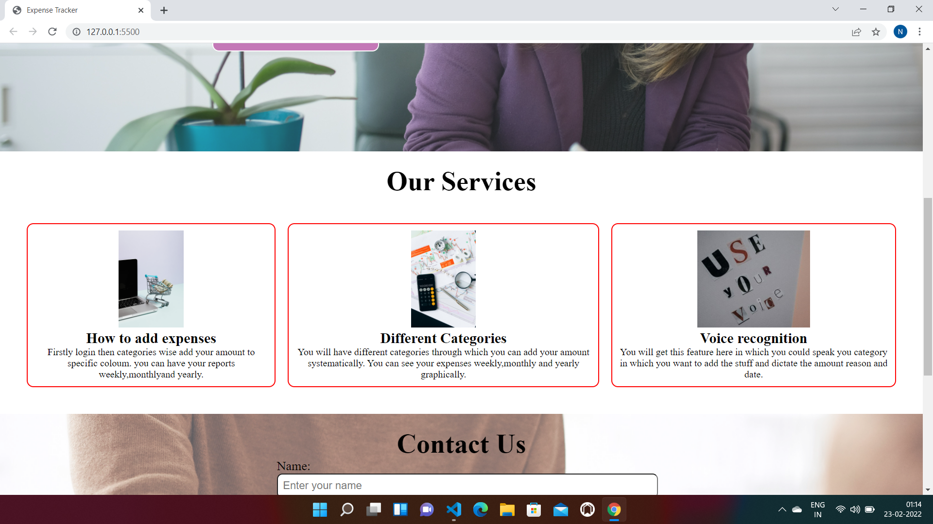

Slide 11
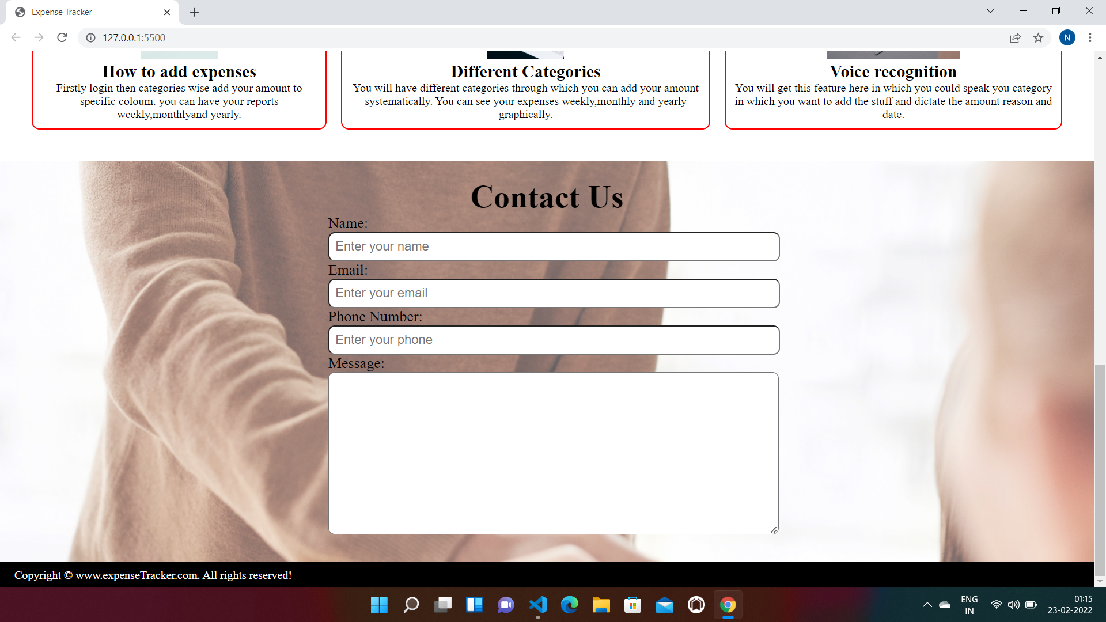

Slide 12
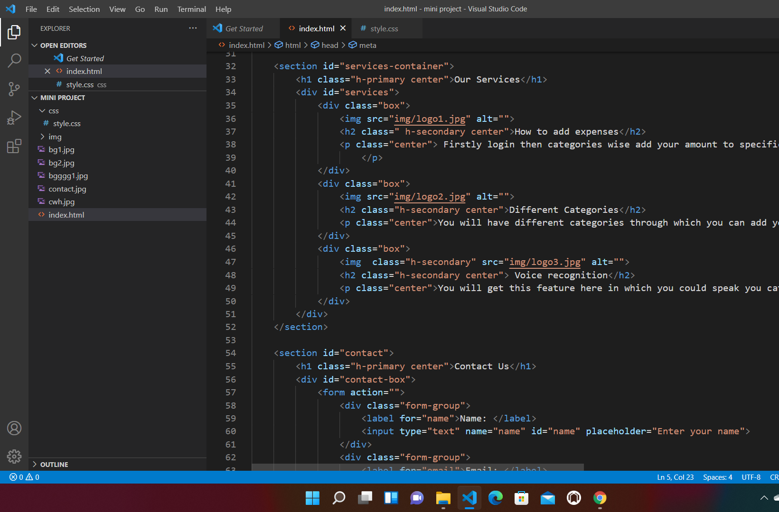
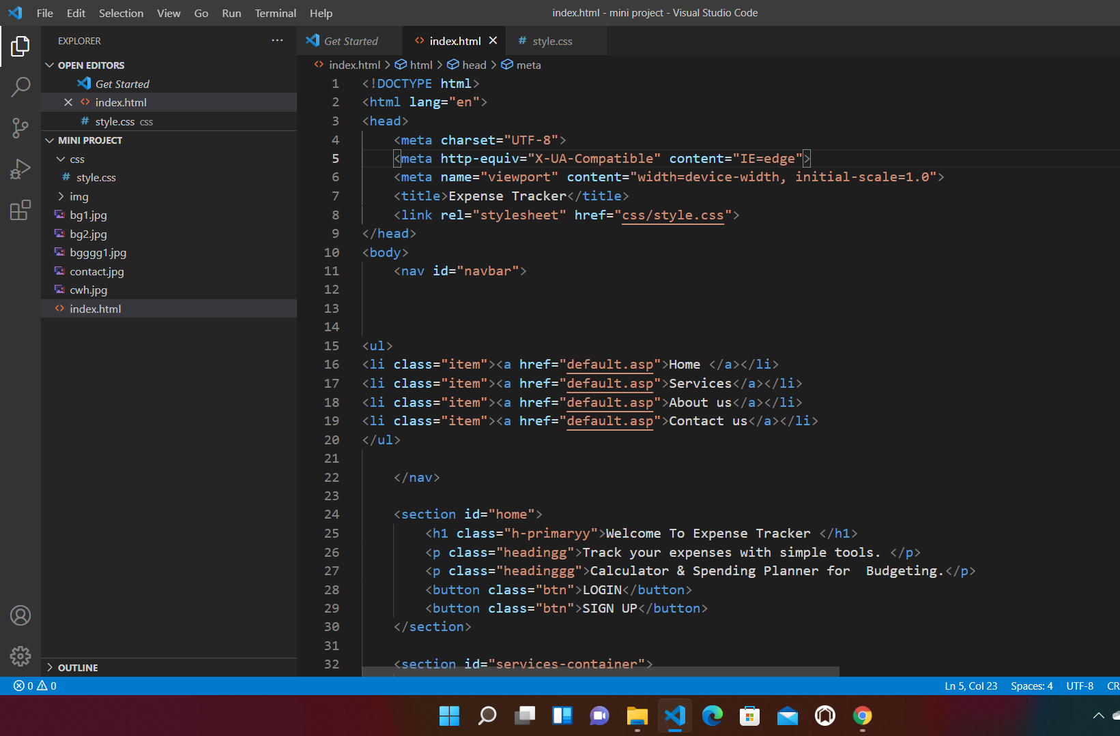
CODE

Slide 13
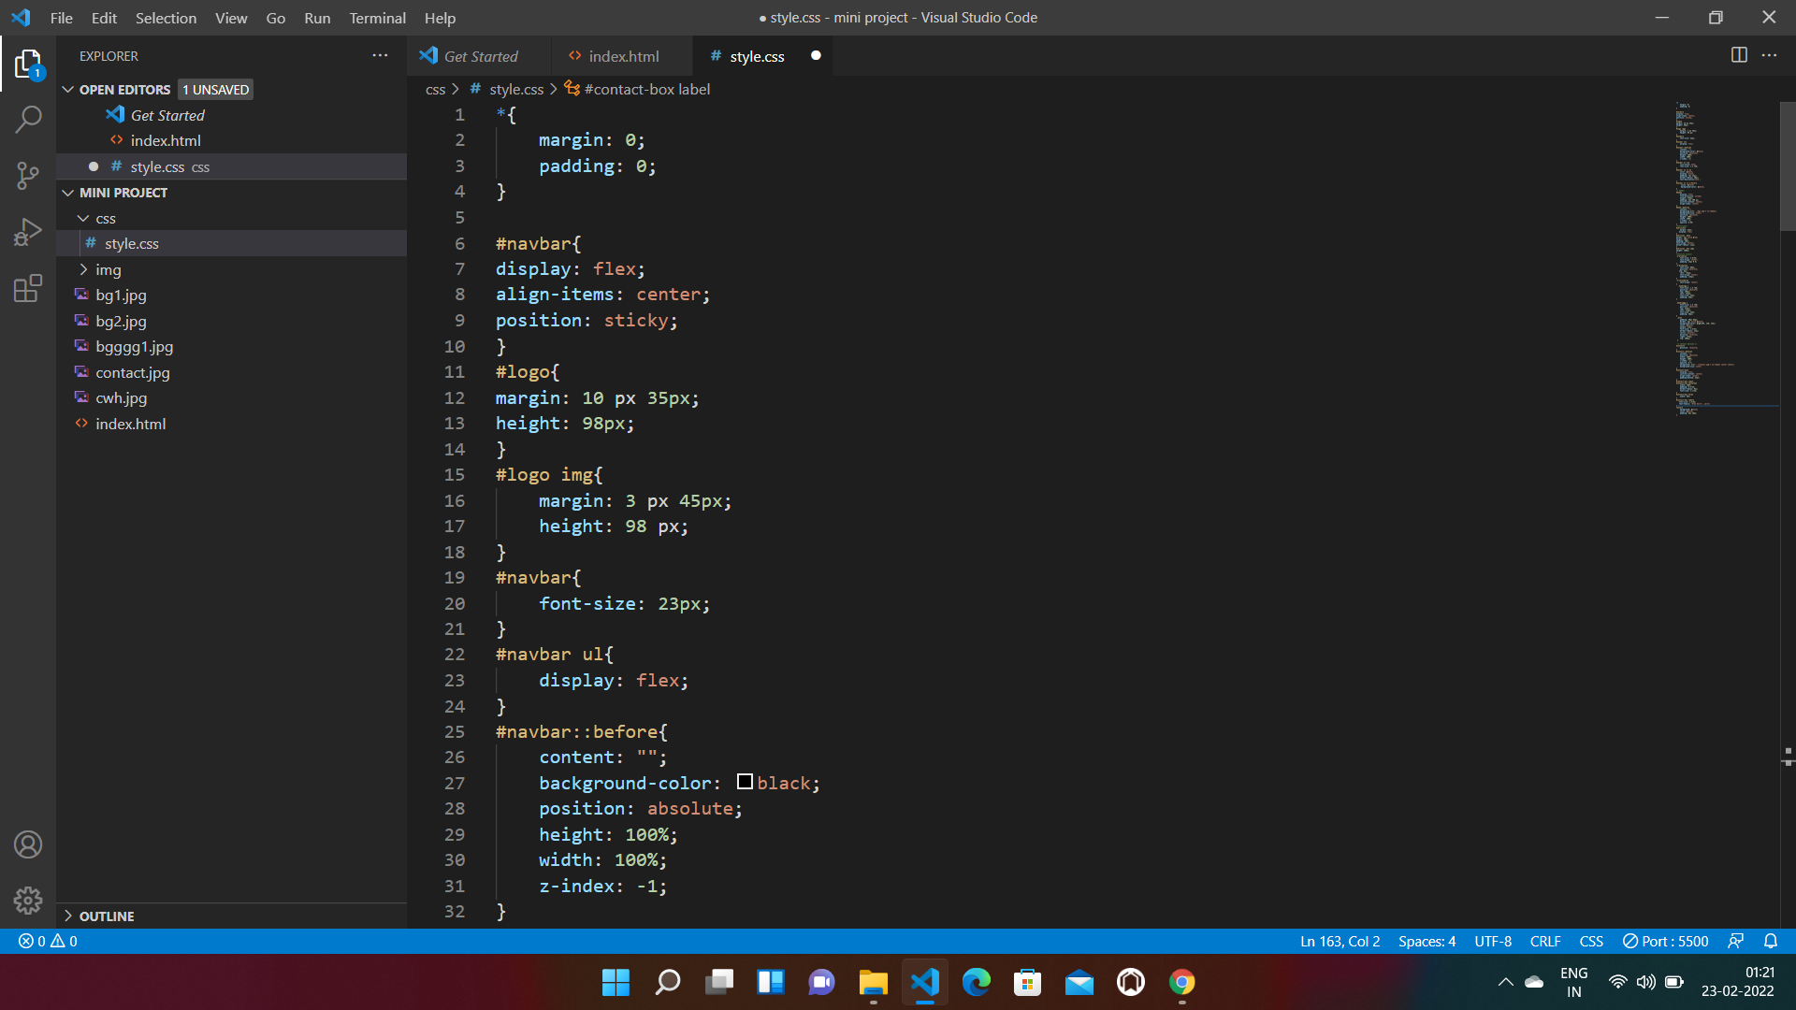
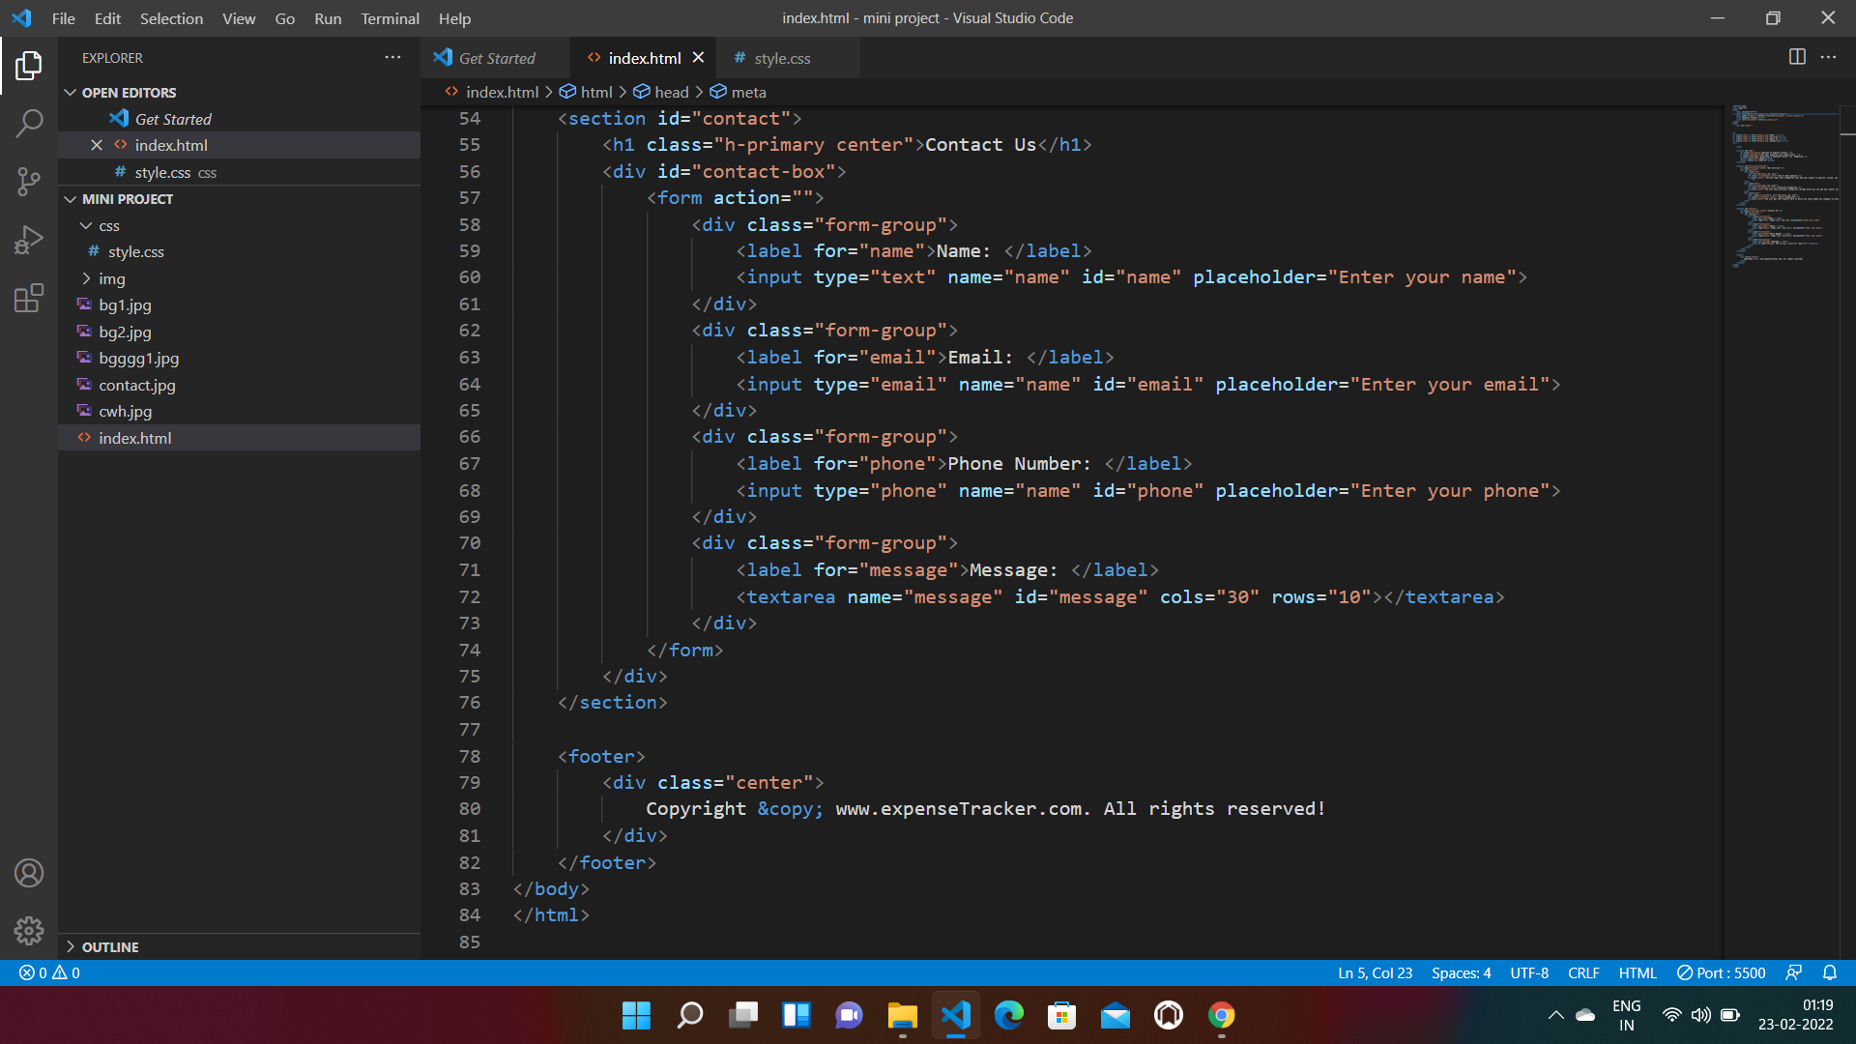

Slide 14
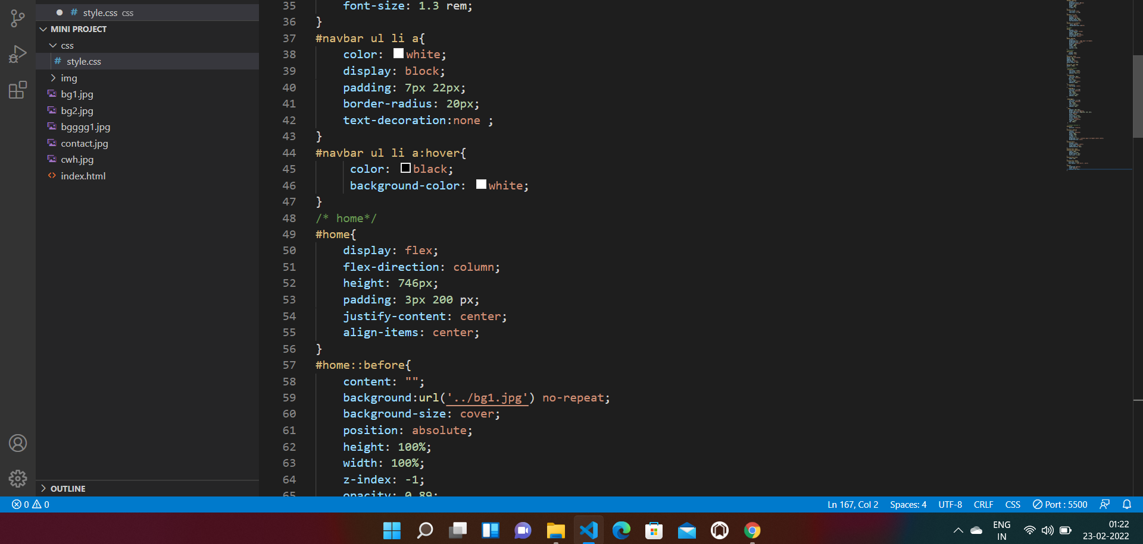

Slide 15

THANK YOU

